Slide 1


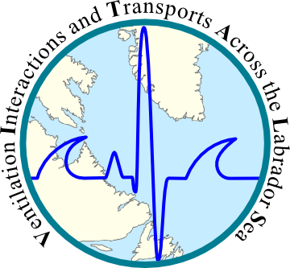


Sub-mesoscale modelling of the Labrador Sea
Clark Pennelly and Paul Myers
Department of Earth and Atmospheric Sciences
University of Alberta
Edmonton, Alberta, Canada

Slide 2
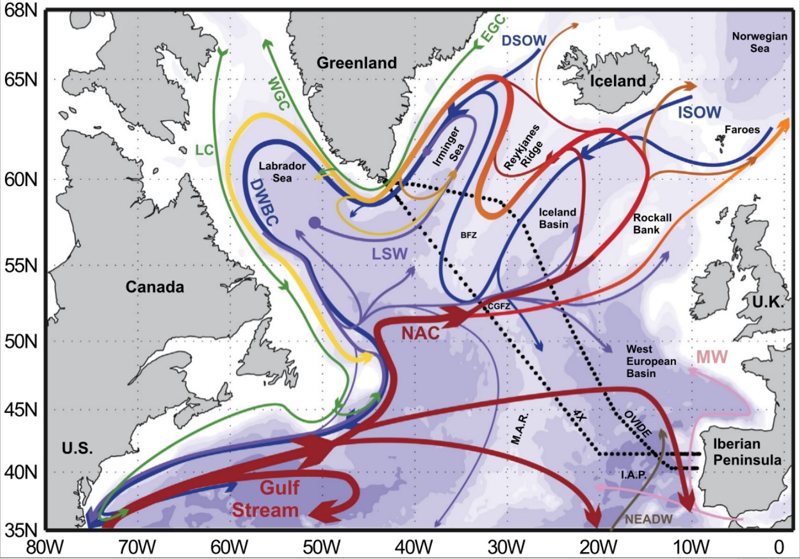
The Labrador Sea

Slide 3
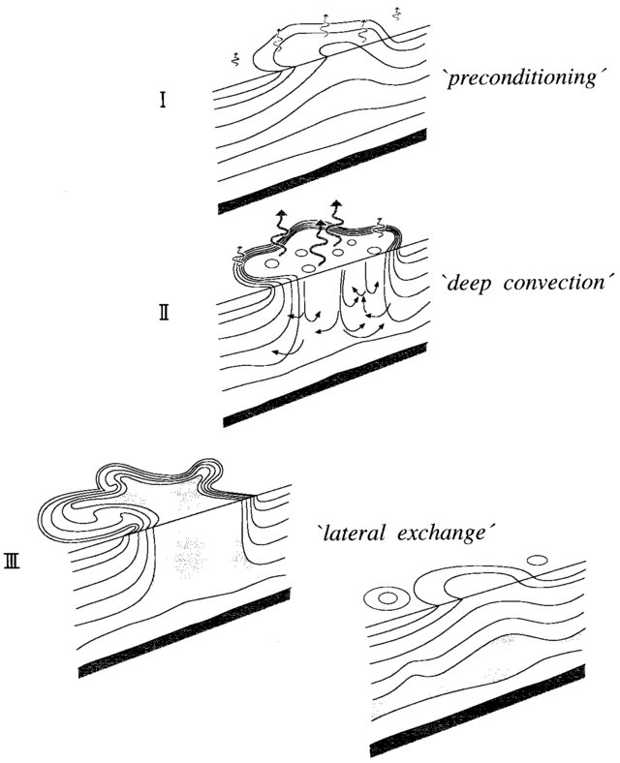
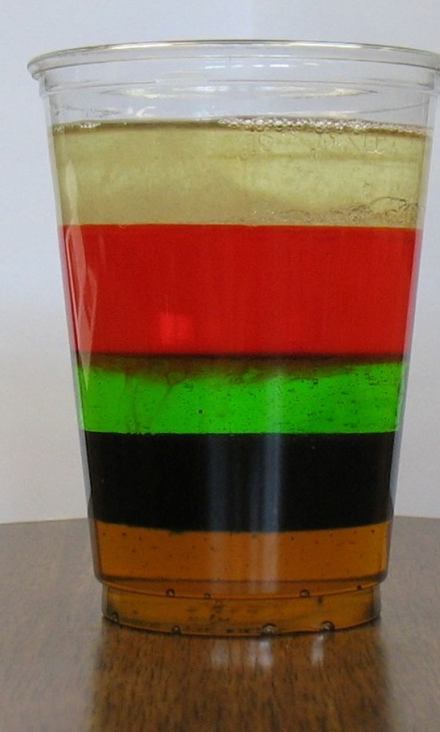
Deep Convection
Weakly stratified via isopycnal doming + water masses preset
“The Labrador Cup”
Freshwater cap
Irminger Water
Air sea heat loss cools the surface, increasing density
Labrador Sea Water
Overflow
Water
Convection ceases, large lateral density gradient exists
Left with newly produced Labrador Sea Water (LSW)

Slide 4
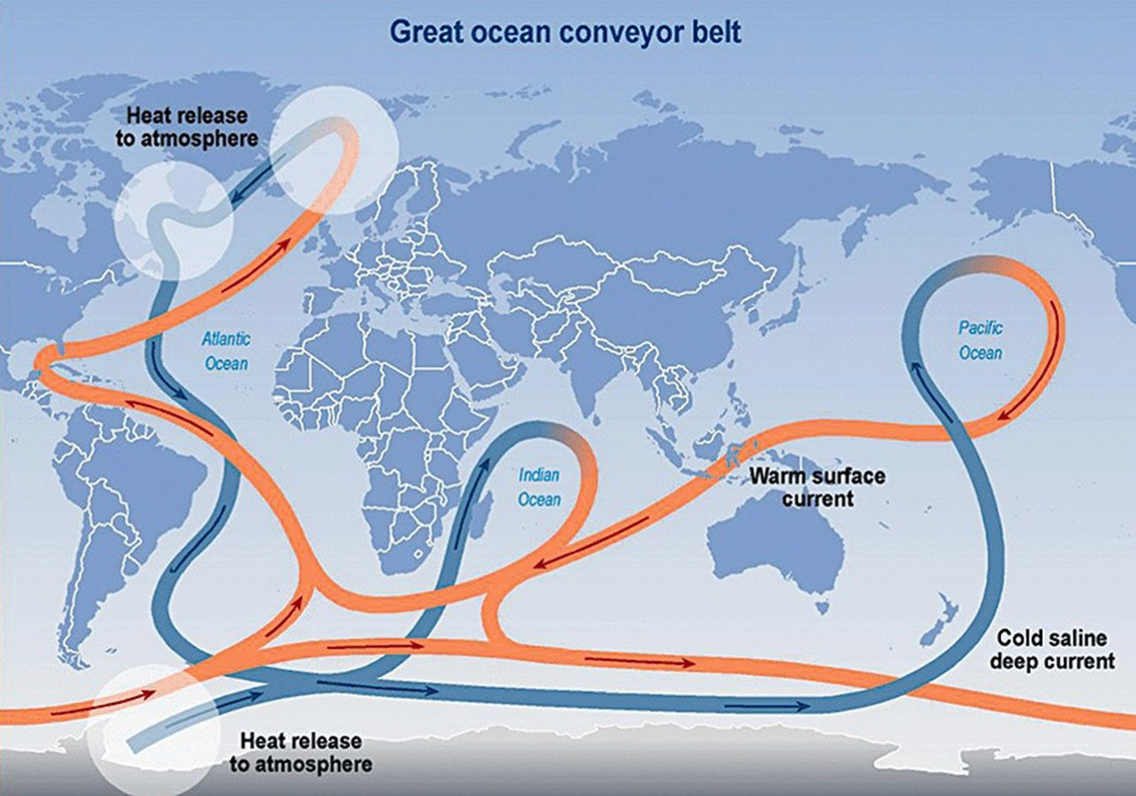
LSW in the AMOC

Slide 5
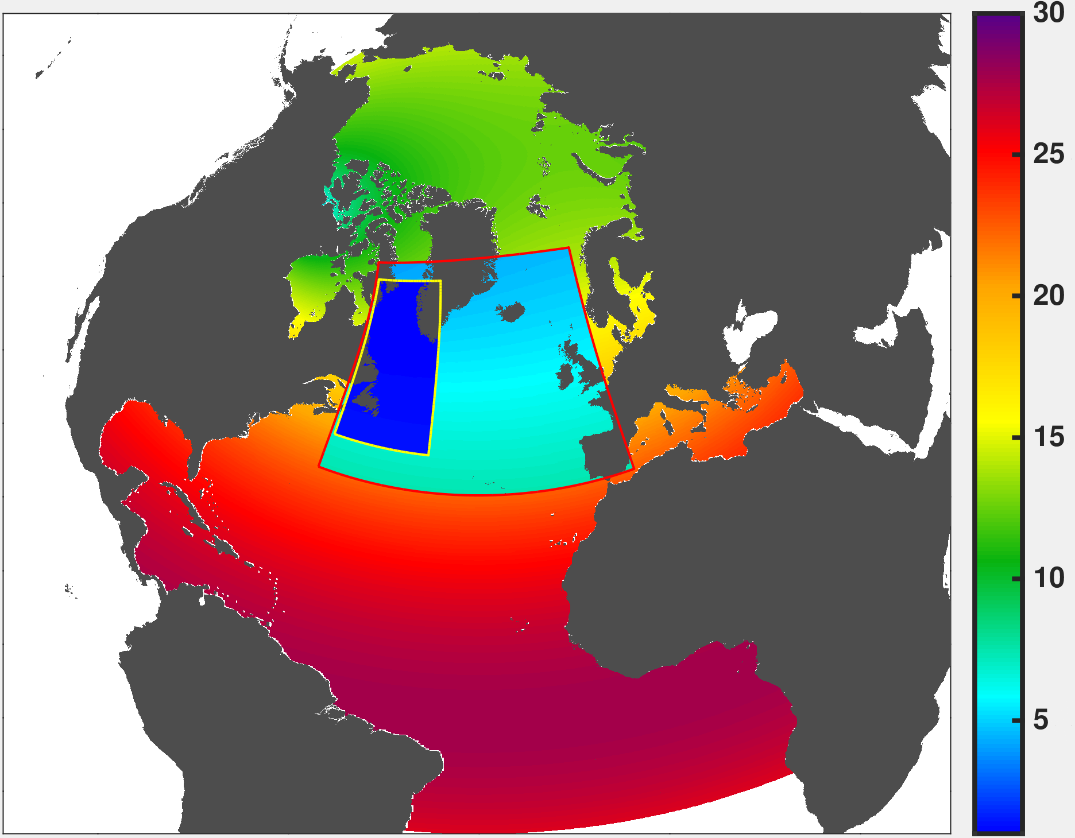
“LAB60”
H. Resolution
ANHA4-SPG12-LAB60
NEMO 3.6
2002-2019 (planned)
75 vertical levels
40s timestep
2 way AGRIF nesting
No-slip BC in 1/60 nest
DRAKKAR forcing 5.2
Monthly runoff
4 Passive Tracers:
-Greenland Melt
-Irminger Water
-CAA outflow
-Labrador Sea Water
1/60°
1/12°
1/4°

Slide 6
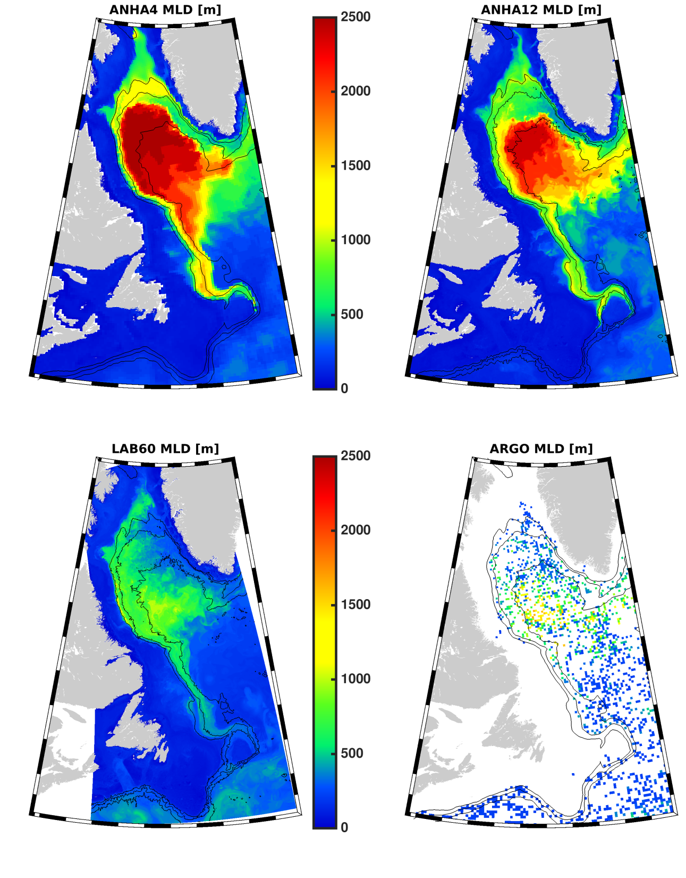
Mixed Layer Depth
Model/ARGO grid point maximum MLD 2004-2016
1/4° way to deep and spacious
1/12° getting better
LAB60 looking pretty good
MLD are very different between simulations, likely the same with stratification

Slide 7
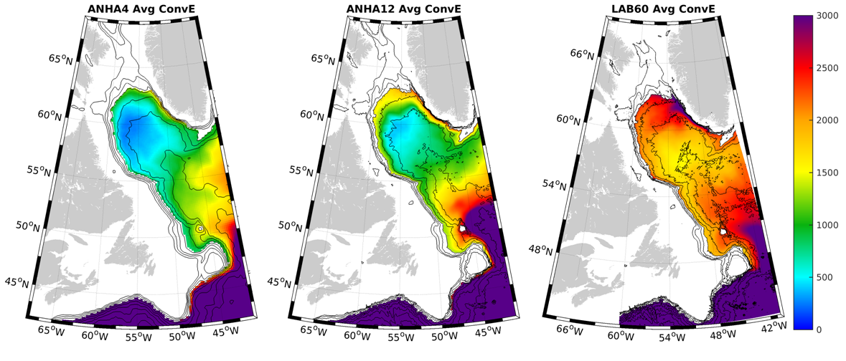
Convective Energy: stratification strength
Amount of energy needed to be removed such that the water column is neutrally stratified to some reference depth (2000m)
Low resolution, weak stratification

Slide 8
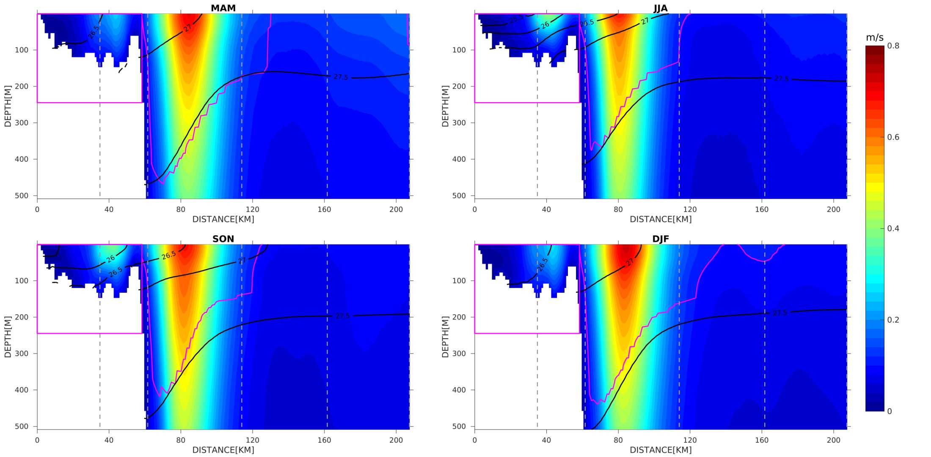
Active Research Topics from LAB60: West Greenland Coastal Current Ruijian Gou
Section southwest of Cape Desolation, Greenland

Slide 9
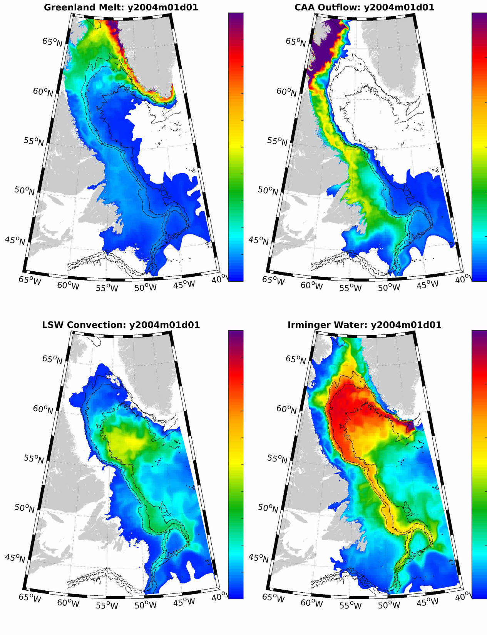
Passive Tracers
Greenland runoff tracer:
Very fresh, enhanced melting
Impacts LSW formation
Canadian Arctic:
Fresh Arctic water
Might enter interior LS basin
Labrador Sea Water:
Water formed during convection
Interested in spreading pathways
Irminger Water:
Warm and salty water
Supplies a lot of heat to the Lab Sea

Slide 10
Irminger Rings may have a dual role in the Labrador Sea
Irminger Ring life cycle:
Formation: Eddy is strongly stratified
First winter: Eddy’s stratification is reduced
Restratification period: Lateral mixing is minimal; eddy stratification increases less than background L.S.
Second winter: Eddy is preconditioned, maybe weaker stratification than background L.S.
Hypothesis: Irminger Rings may produce Labrador Sea Water if they experience 2 convective winters

Slide 11
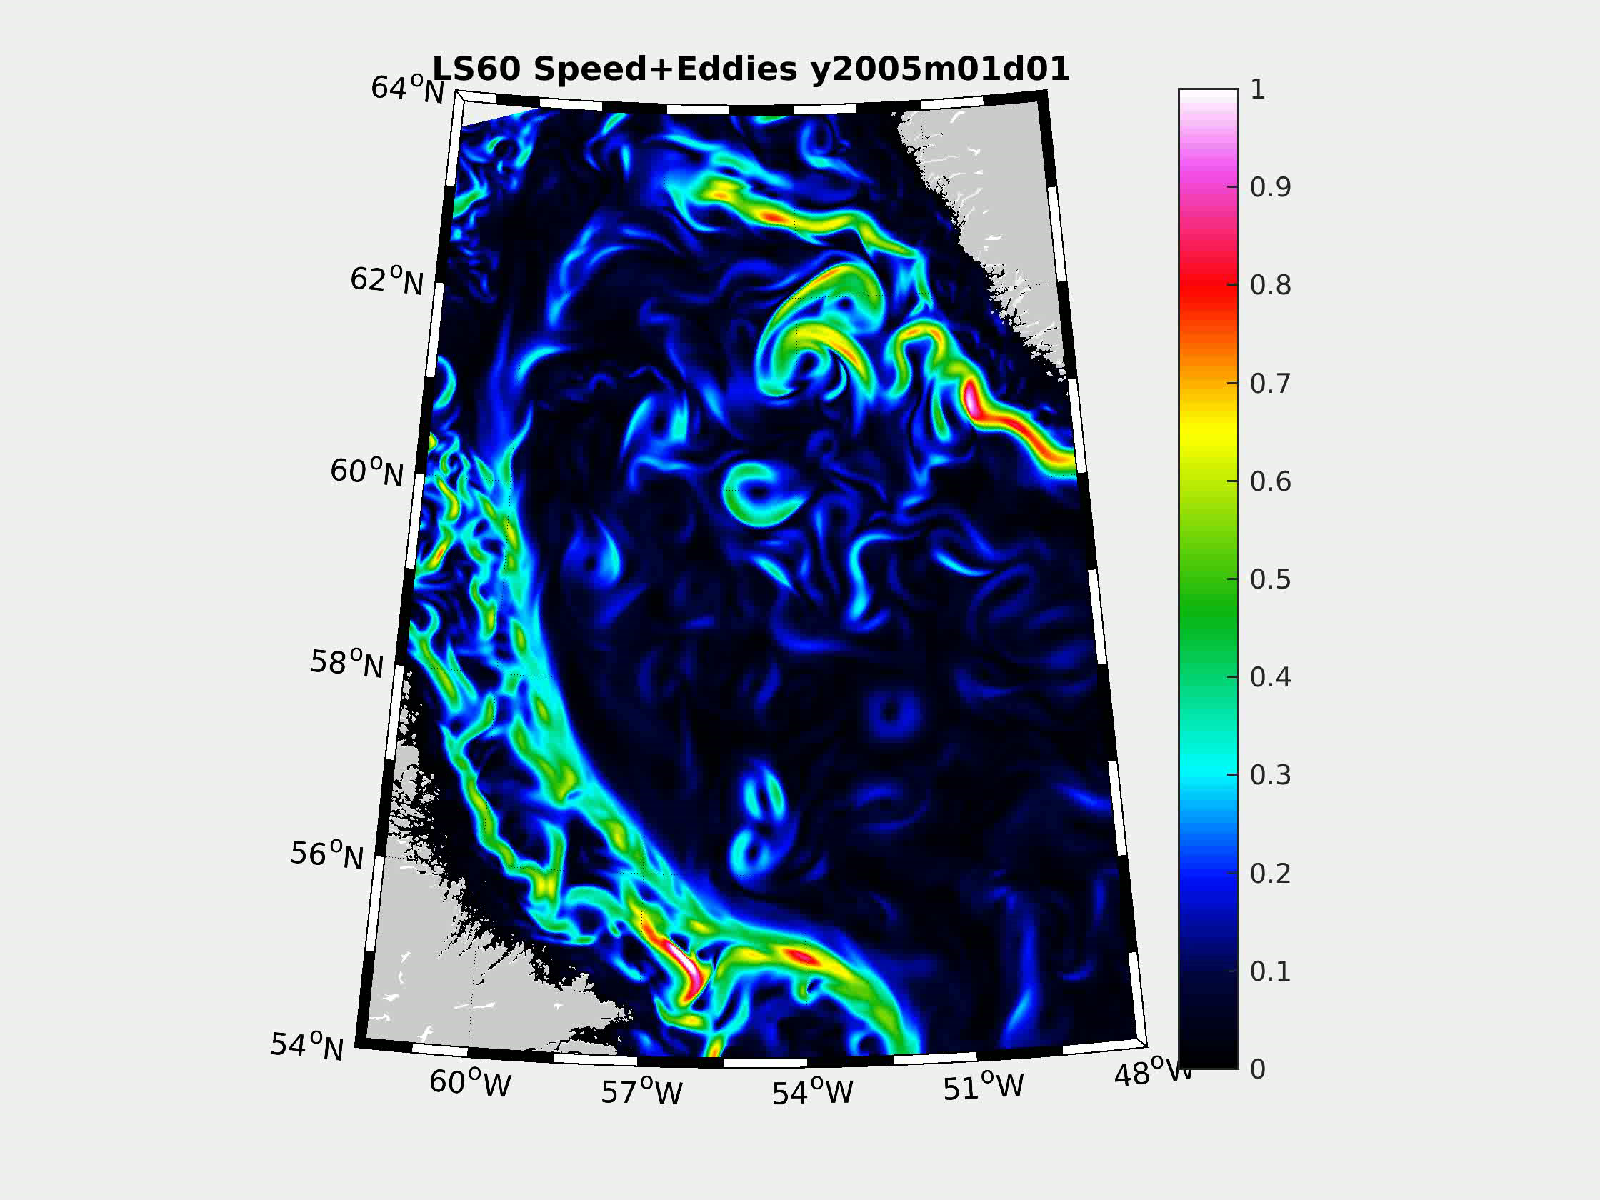
Irminger Rings
Produced via baroclinic/barotropic instabilities of the WGC
FW at surface with warm salty subsurface layer
Radius 15-25km
10-30 per year
Often anti-cyclonic
Live up to 2 years

Slide 12
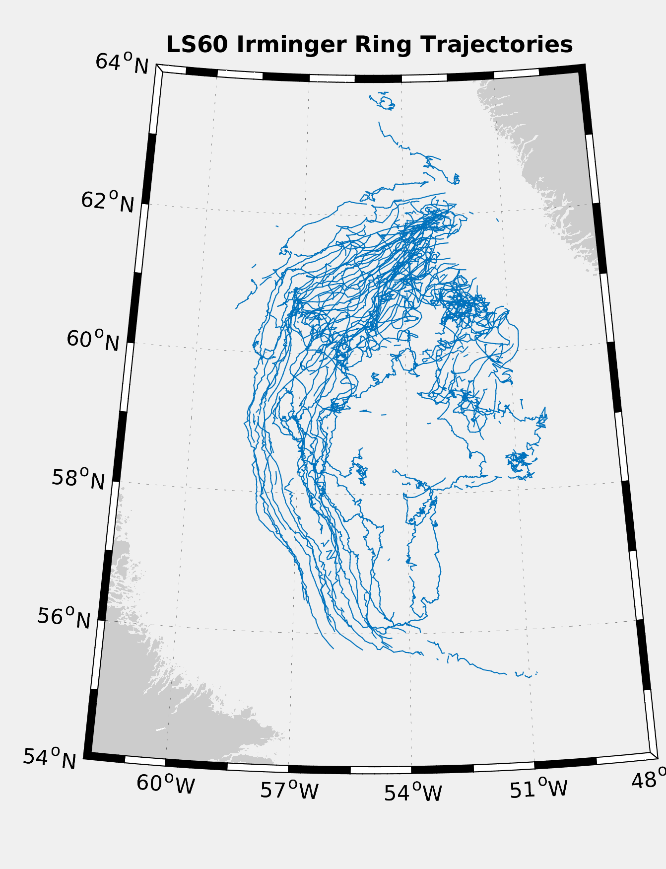
Eddy Trajectory (5 years of data)
Some due south
Very few travel north
Most travel southwest, cyclonically around the basin

Slide 13
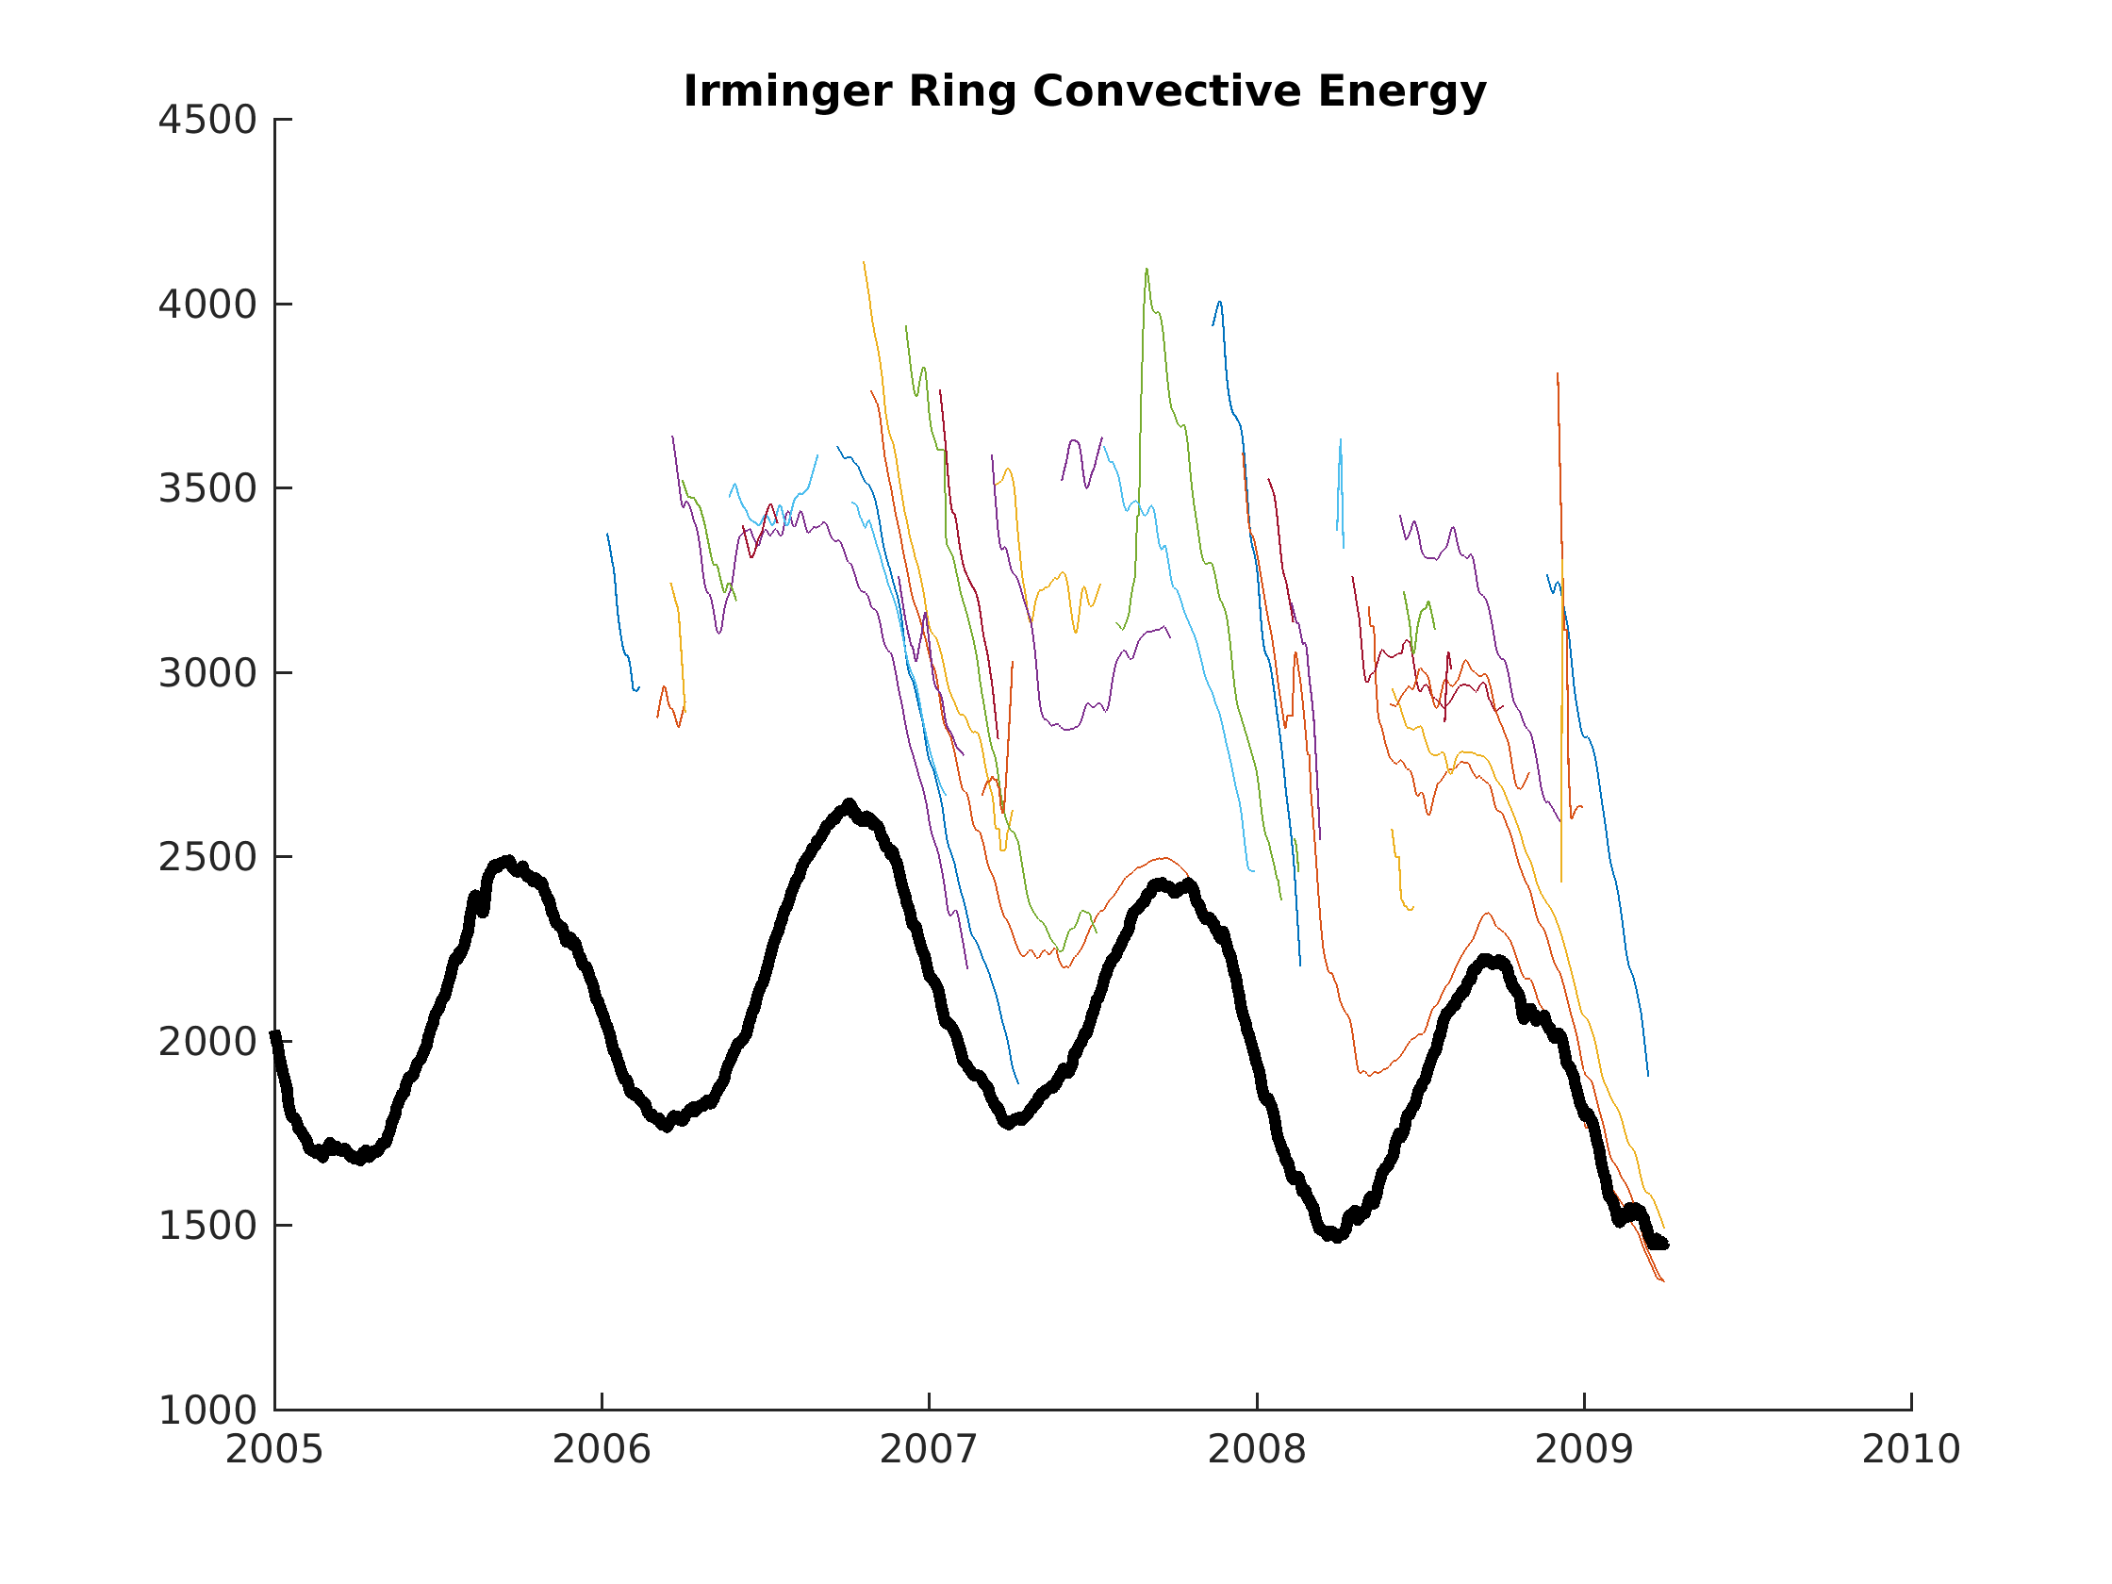
Eddy Stratification Vs Background LS
Individual Irminger Rings
Eddies start strongly stratified
Stratification is lost during winter
Eddies rebuild stratification slower than the background LS
Background Labrador Sea
Simulation Year

Slide 14
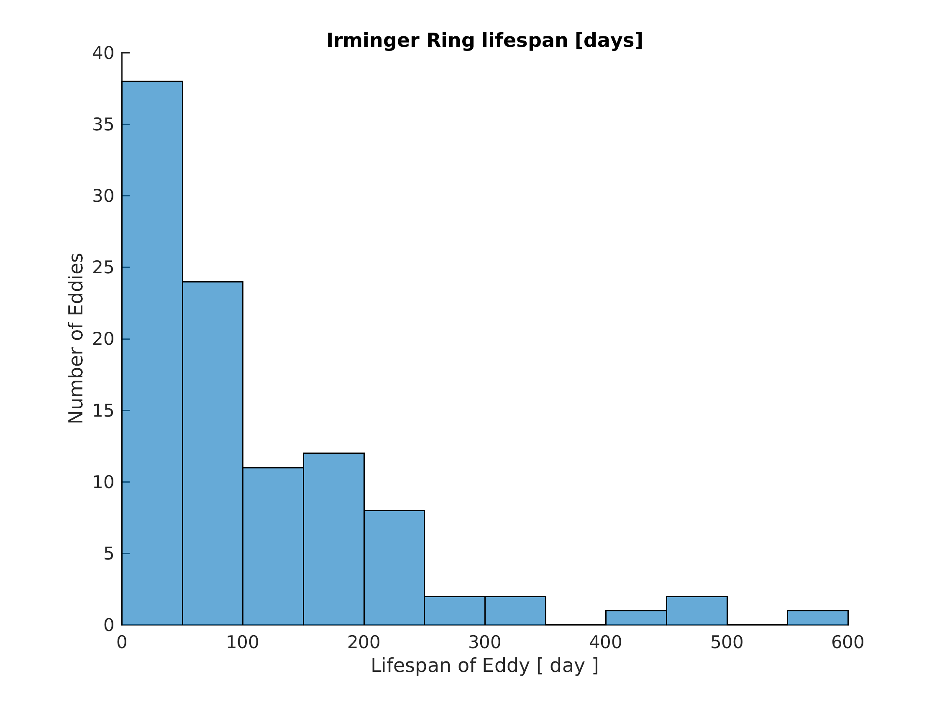
Eddy Lifespan
Most simulated eddies are short lived
Interested in eddies which may experience 2 convective seasons

Slide 15
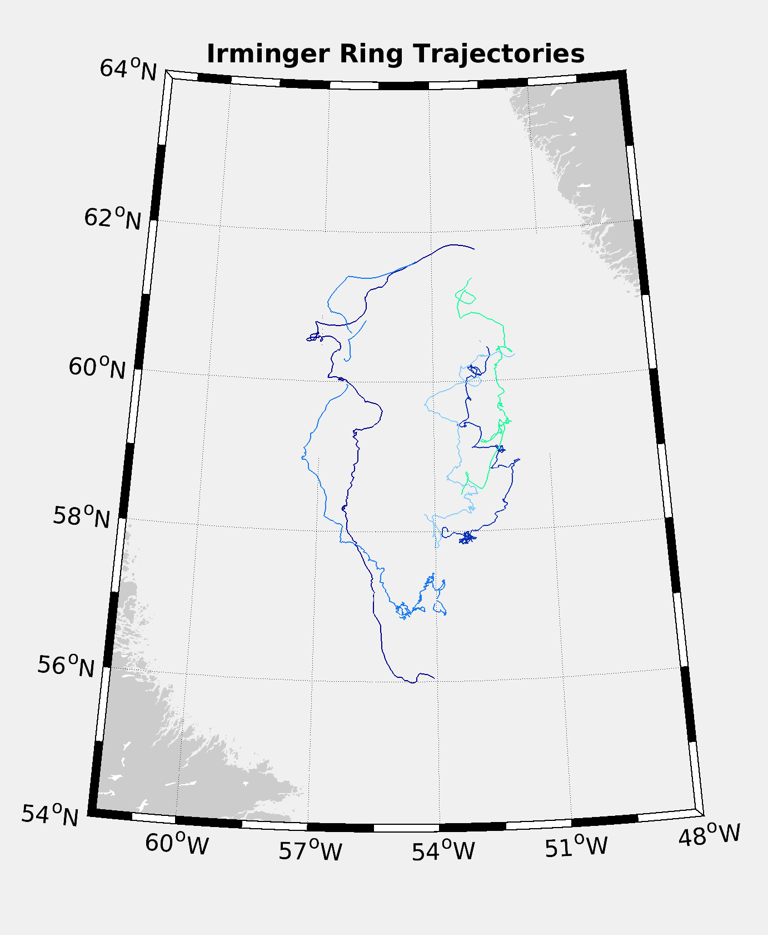
Long Lived Eddies
Their path is similar to the other Irminger Rings, perhaps further offshore

Slide 16
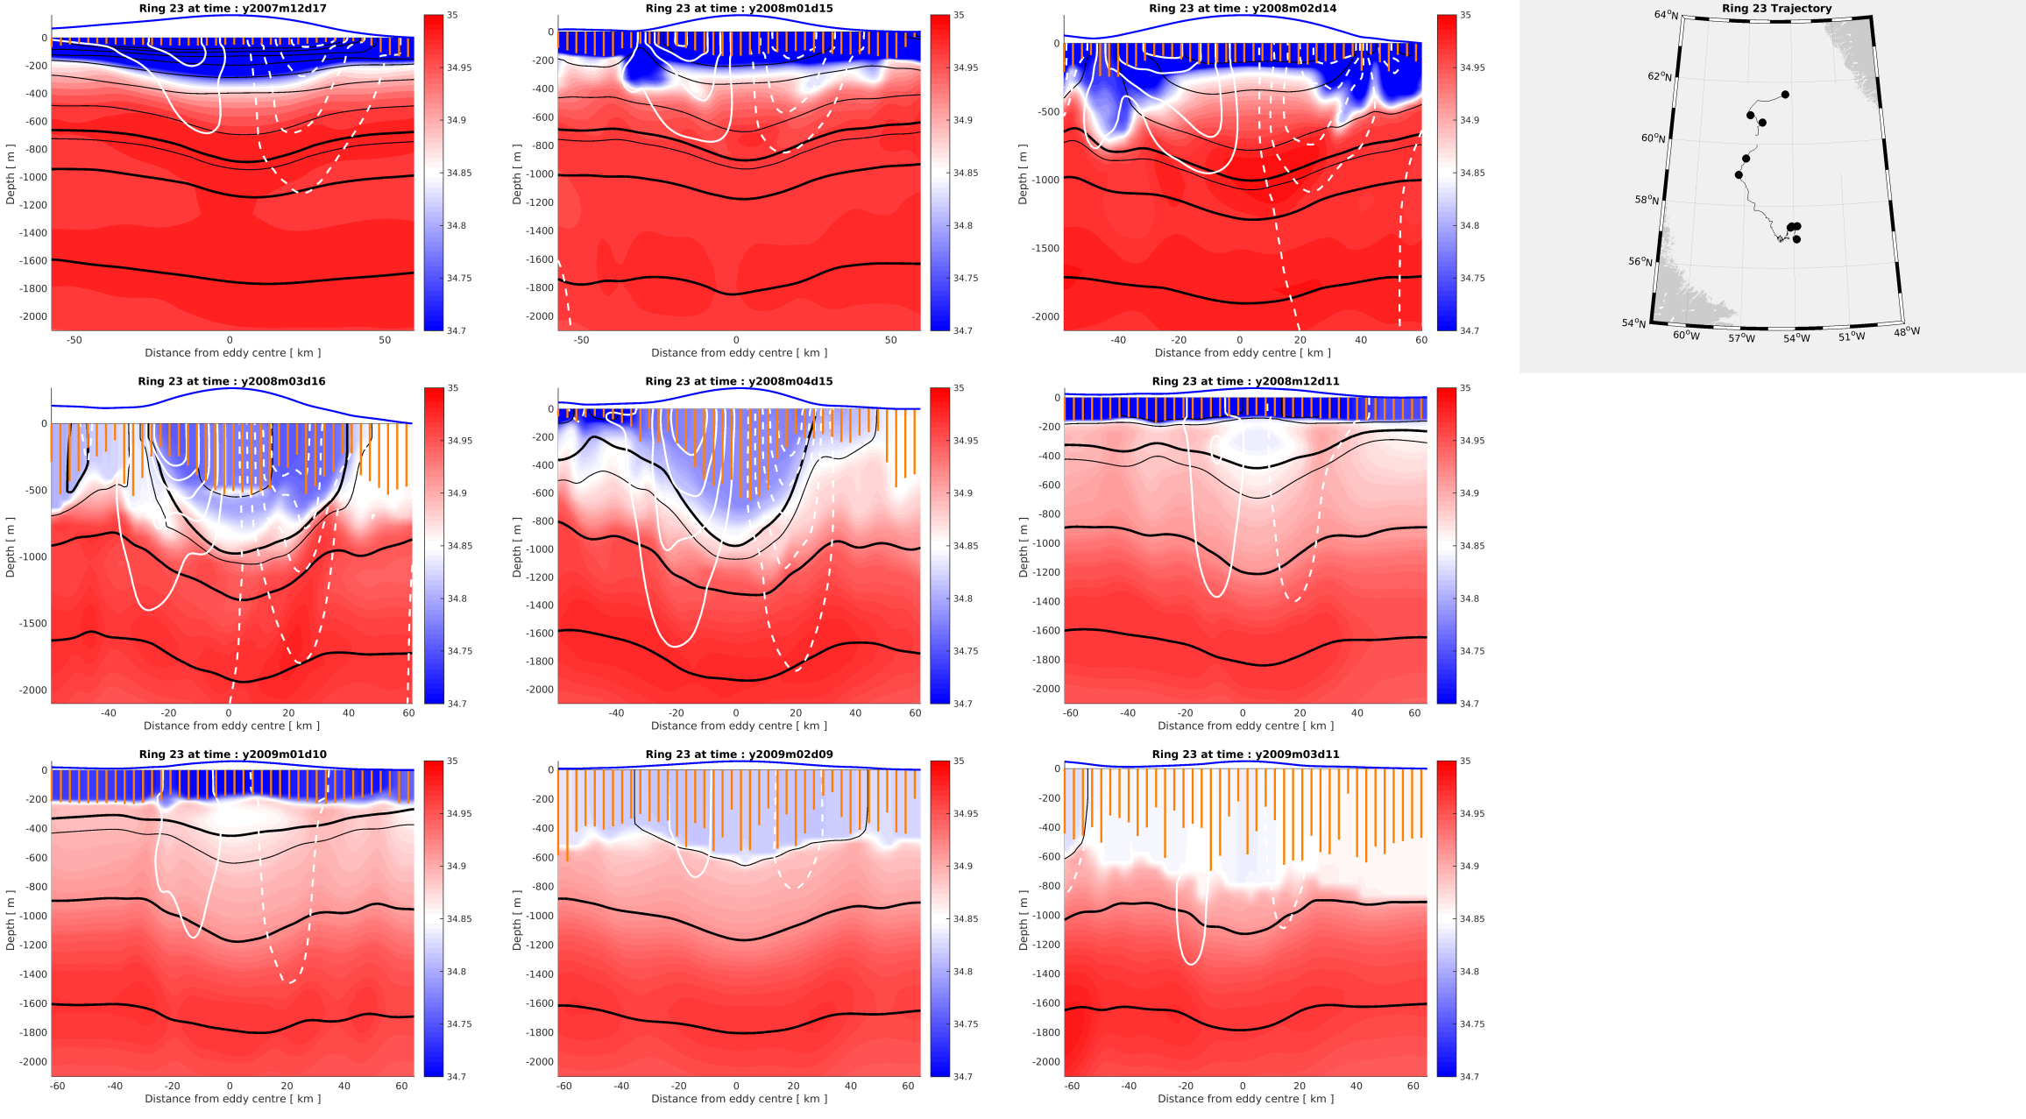
Cross Section of Eddy Producing LSW
Blue Line: SSH
Orange Bars: MLD
White Contours: Speed
Black Contours: isopycnals
-Thick: LSW
Filled Contours: Salinity

Slide 17
Conclusion
We have set up a lengthy 1/60° simulation in the Labrador Sea and found that higher resolution:
keeps the basin from being too weakly stratified
prevents the MLD from being too deep/widespread
produces Irminger Rings which can form Labrador Sea Water under certain circumstances
Further questions/comments? Email me: Pennelly@ualberta.ca

Slide 18
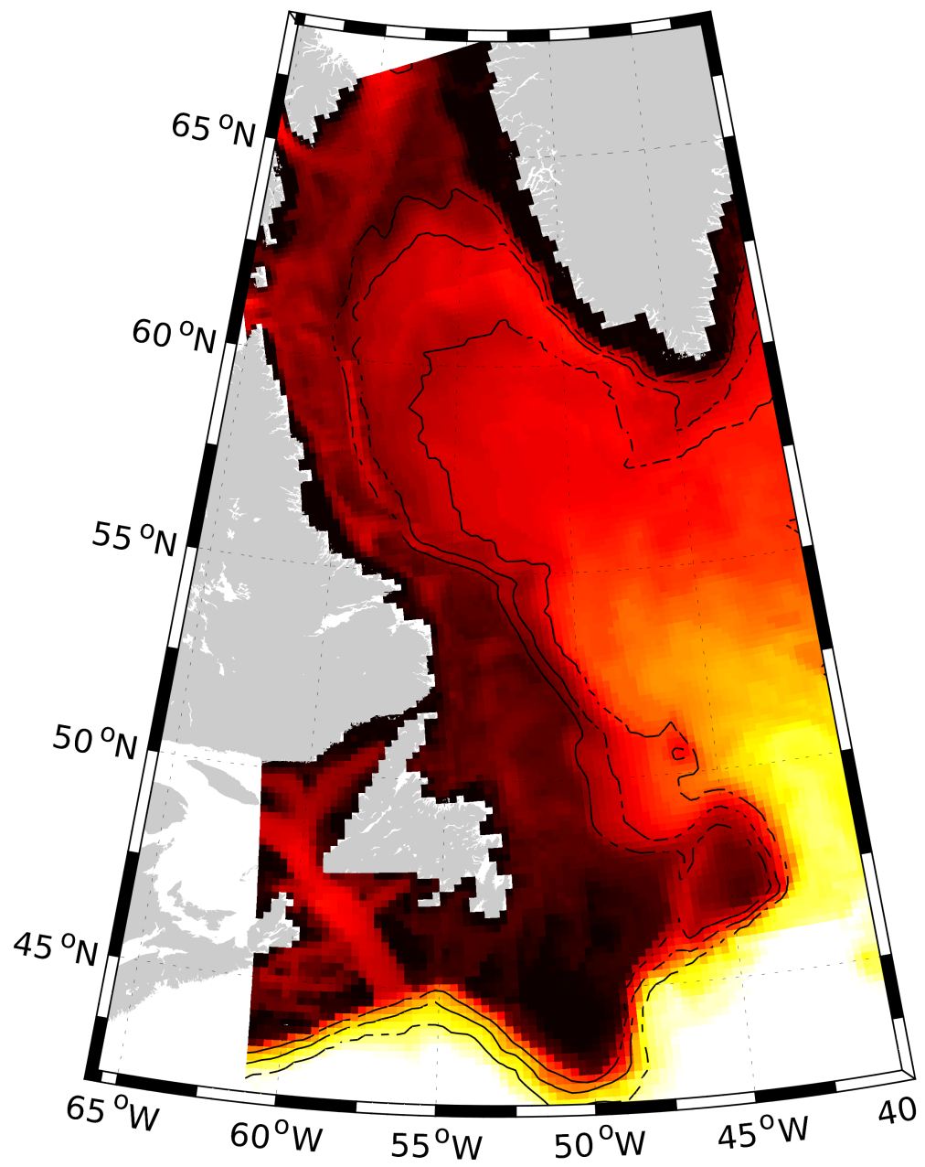
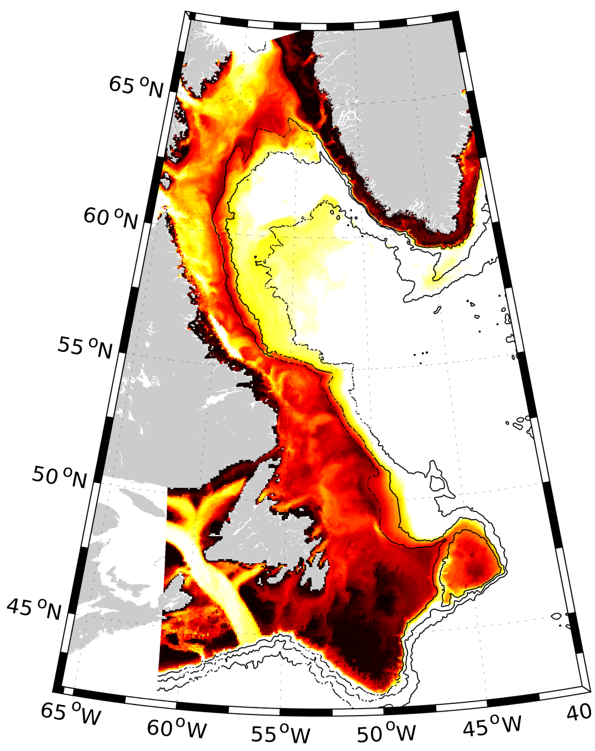
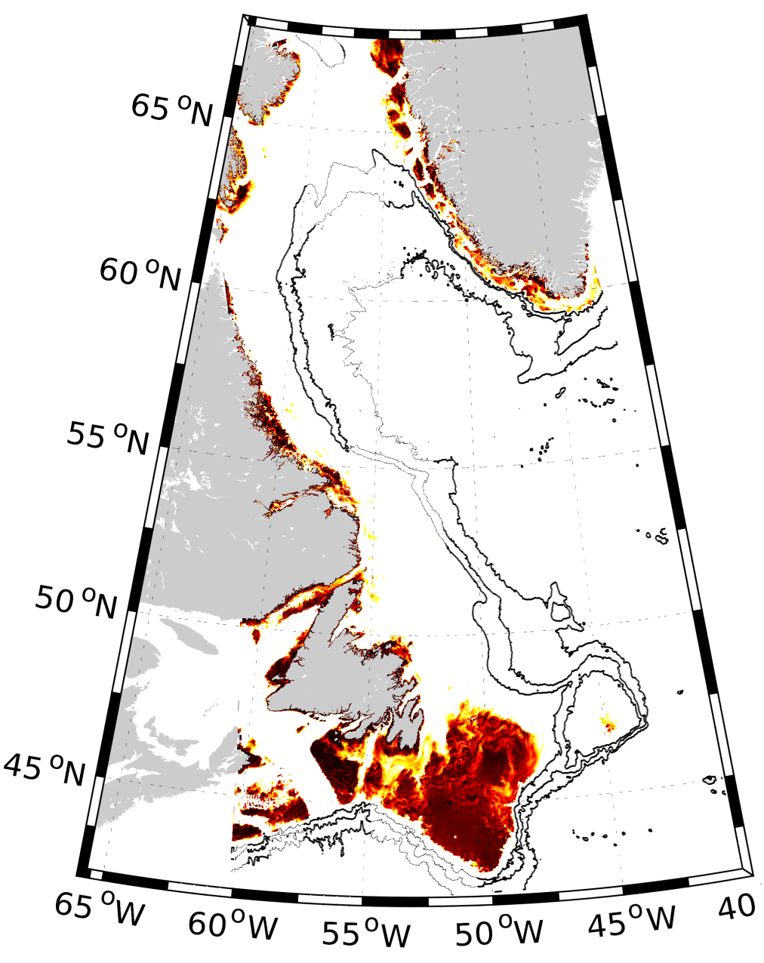
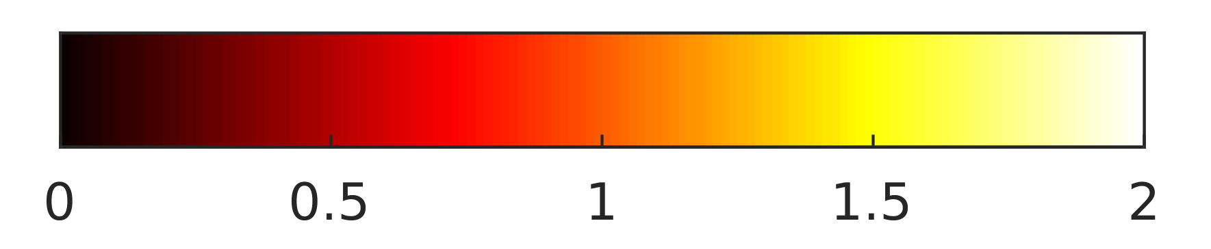
Why push for high resolution
Horizontal resolution determines eddy-resolving power
Eddies shed from the boundary currents supply a significant amount of freshwater and
heat, influencing the stratification in the region.
1/4°
1/12 °
1/60 °
Grid cells per deformation radius

